Slide 1
RiskModel SAS Platform Migration
Overview
Nov 2019

Slide 2
RiskModel GCP/ML Pilot – What?
Migrate RiskModel SAS Platform form PC SAS to SAS Grid on Linux (Titan)
Develop model
Run automated RM simulation for model surveillance and testing
X
X

Slide 3
RiskModel GCP/ML Pilot – Why?
To improve productivity and efficiency
Cost saving

Slide 4
SAS Platform Migration
Issues | Solution | Result
Team consensus to migrate | Discussion within team, and with John, ok to move forward. | x
Team member access to Linux | All team members applied and got access to Linux | x
Team member to run sas on Grid via EG | All team members added to sas metadata | x
Install EG on laptop (US team) | Tested ok | x
Network drive mount to Linux (Titan/(Dione)) | Done (Titan for now, Dione later maybe) | x
Network drive backup | RiskModel1-RiskModel3 in backup rotation; Requested backup for RiskModel4 and RiskModel5 and is completed. | x
Network drive file access | Tested ok (dir/folder created in windows have different owner id from linux owner id, simple solution is to create folders in linux (can also be done easily in EG using sas)) | x
Model development on Linux | Tested ok (necessary changes to sas codes) | x
Integrated Simulation | Linux SAS Grid and Windows RM ---- tested ok, further refinement (necessary changes to sas codes, VB script, .bat executable file) | x
Access onesource database from Linux | Requested unix ODBC setup. ---- unixODBC installed, request to set up with SAS Grid...
Training and transition | Nov – Dec, team members to test, adopt; will also provide training along the way depending on the need
PC SAS phase out | Jan - Feb
…

Slide 5
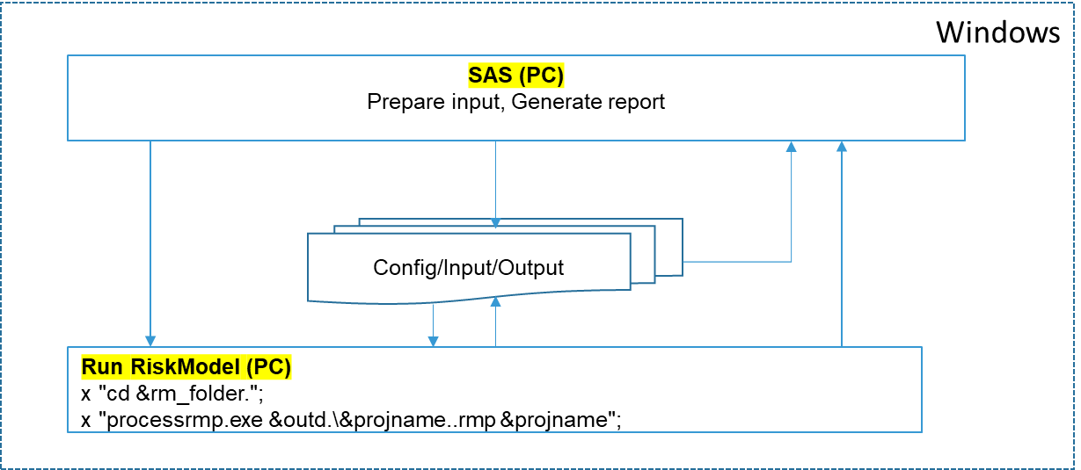
Key Challenge - How to run Integrated RiskModel Simulation
Currently RiskModel application and PC SAS are bundled in Windows environment. Integrated Simulation is run by executing SAS program that prepare input data for simulation, call RiskModel application to run simulation, then collect results to generate reports

Slide 6
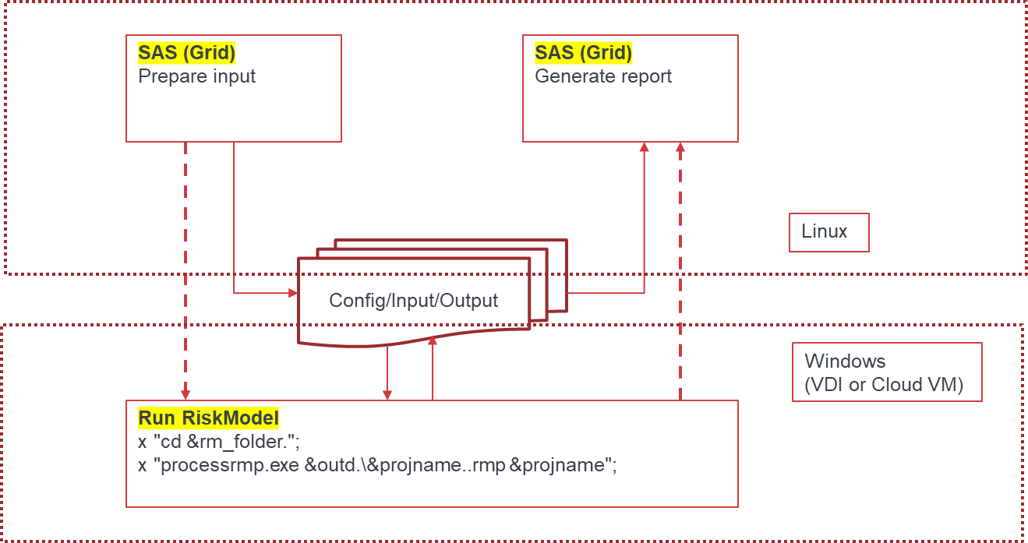
Solution – Conceptual Framework
The solution is to develop the most reasonable communication scheme so that the process can be broken into 3 parts to run sequentially
Data preparation (SAS Grid on Linux)
Simulation (RiskModel Application in Windows)
Report generation (SAS Grid on Linux)

Slide 7
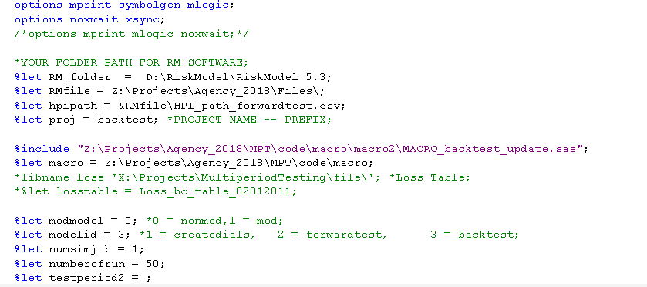
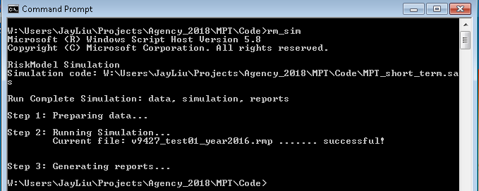
Solution – New Process: Min. Pain Transition
Step 1: Setup (config) the simulation in SAS program exactly the same way as today
Step 2: Give the path and name of the SAS program to rm_sim.bat (a one-line executable file)
Step 3: Run rm_sim.bat

Slide 8
Additional Changes Needed
rm_sim.bat is a one-line windows executable as shown
cscript.exe is a windows schedule script that is available in Windows system
rm_sim_spt.vbs is a Windows VB script that we developed for the simulation
SAS EG need to be installed in order to run sas program on SAS Grid
Necessary code change in the simulation sas program, including but not limited to changes to separate data preparation and reporting, directory change, upper/lower case change, some import/export code change, etc…

Slide 9
Thank You

